Slide 1

MODULE -7 CONFIDENCE BUILDING (activity session) LANGUAGE BARRIER,IMPROMPTU SPEECH IT POLICIES BRIFING

Slide 2
NAME KAJAL RATHOD CURRENT STATUS * STUDENT AT TOPS TECHNOLOGIES ,PURSUING TRAINING IN DATA ANALYTICS EDUCATIONAL BACK GROUND * MASTER OF SCIENCE IN CHEMISTRY FROM VEER NARMAD SOUTH GUJRAT UNIVERSITY ,SURAT KEY PERSONALITY TRAITS * DETAIL ORIENTED,ENSURING ACCURACY IN DATA ANALYSIS * GOOD AT COMMUNACATING COMPLAX DATA TO BOTH TECHNICALLY AND NON TECHNICAL STACKHOLDERS * CREAT VISUAL DASHBOARD

Slide 3





TECHNOLOGY PROJECT
“used car e commerce stats for buyers,sellers and advertisers”

Slide 4
INTRODUCTION 1) High increase in used(2nd hand) car sales in recent years 2) Used cars: fairly good condition ,low cost 3) E-commerce website have triggered used car 4) Popular E-commerce website for selling used cars:ebay 5) Which are the popular brands in the used car market ? 6) Which are the popular vehicle types in the used car market ? 7) The selling price ( ad price) of a used car depends on what factor and catagorys ? 8) How will the used car prices be in the future ?

Slide 5
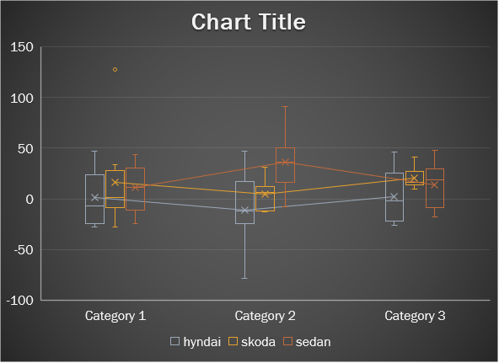
TOP SELLING VEHICLE TYPES IN THE USED CAR MARKET

Slide 6
BUILDING CONFIDENCE & TECHIQUES FOR IMPROMPTU SPEECHES
REGULAR PRACTICE
I am consistently working on my technical skills, dedicating 2 to 3 hours daily to practice, which helps me build my confidence and overcome challenges.
SEEK FEEDBACK
Our faculty assigned us tasks and projects based on certain parameters, such as the cleanliness of our work, communication skills, speech and vocabulary, and overall quality. After evaluating these aspects, my faculty provided feedback, which helped me gain valuable input and grow my confidence.
SET ACHIEVABLE GOALS
My goal is to master data analytics and secure a good job that offers a competitive salary, to support my growth and my family.
POSITIVE MINDSET
a positive mindset boosts my confidence ,so I always stay positive to keep my confidence growing.

